Slide 1
Distributed Web Based System
Name: Kunal Santosh Kadam
PRN No. : 2019BTECS00064
Course: Advanced Database System Lab

Slide 2
World Wide Web
Viewed as huge distributed system with millions of clients and servers for accessing linked documents
Servers maintain collections of documents
Clients provide user an easy-to-use interface
Document is fetched from server, transferred to client and presented on screen
With emergence of Web service, it is becoming a system of distributed services rather than just documents offered to any user or machine.

Slide 3
Traditional Web Based Systems
Many Web-based systems are still organized as relatively simple client-server architectures.
The core of a Web site is formed by a process that has access to a local file system storing documents.
The simplest way to refer to a document is by means of a reference called a Uniform Resource Locator (URL).

Slide 4
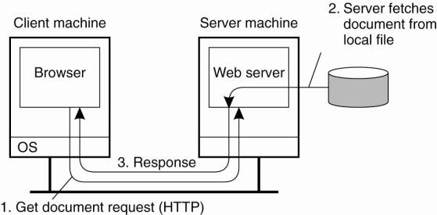

Slide 5
Uniform Resource Locator
A reference called Uniform Resource Locator (URL) is used to refer a document.
The DNS name of its associated server along with a file name by which the server can look up the document in its local file system.
The URL also specifies the protocol for transferring the document across the network.
Example
http//www.cse.unl.edu/ylu/csce855/notes/web- system.ppt

Slide 6
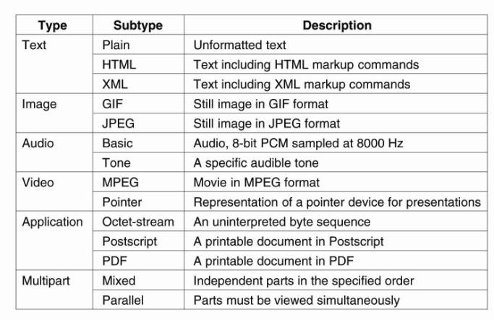
Web Documents

Slide 7
Multitiered Architecture
Web documents can be built in two ways
Static locates and returns the object identified in the request. Static objects include predefined HTML pages and JPEG or GIF files. Does not require web servers to communication with any server-side application.
Dynamic the request is forwarded to an application system where the reply is generated dynamically, i.e. data is generated through a server-side program execution.

Slide 8
Because of the server-side processing, many Web sites are now organized as three-tiered architectures consisting of a Web server, an application server, and a database server.
User data comes from an HTML form, specifying the program and parameters.
Server-side scripting technologies are used to generate dynamic content
Microsoft Active Server Pages (ASP.NET)
Sun Java Server Pages (JSP)
Netscape JavaScript
Free Software Foundation PHP

Slide 9
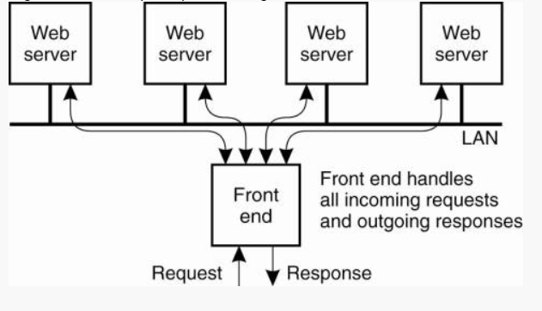
Web Server Clusters
Web server are replicated and combined with front end to improve performance.

Slide 10
The front end can be designed in two ways
Transport-Layer switch – simply passes data sent along the TCP connection to one of the servers, depending on some measurement of the server’s load.
Content-aware request distribution – it first inspects the HTTP request and decides which server it should forward that request to.
Another alternative to set up a Web server cluster is to use round-robin DNS.
With round-robin DNS a single domain name is associated with multiple IP addresses.
When resolving a host name, a browser would receive a list of multiple addresses, each address corresponding to a server.
Normally, browsers choose the first address on the list, but most DNS servers circulate the entries.
As a result, simple distribution of requests over the servers in the cluster is achieved.

Slide 11
HTTP
All communication between clients and servers is based on HTTP. Servers listen on port 80.
HTTP is a simple protocol a client sends a request to a server and waits for a response.
HTTP is stateless it does not have any concept of open connection and does not require a server to maintain information on its clients.
HTTP is based on TCP whenever a client issues a request to a server, it first sets up a TCP connection and sends the message on that connection. The same connection is used for receiving the response.

Slide 12
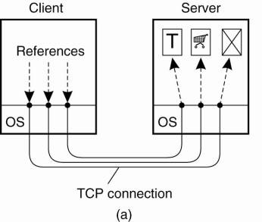
In HTTP version 1.0 and older, each request to a server required setting up a separate connection. When server had responded, the connection was broken down. These connections re referred as nonpersistent

Slide 13
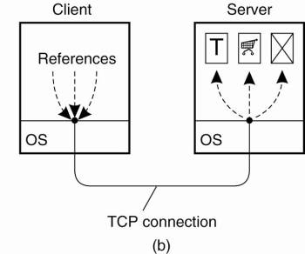
In HTTP version 1.1, several requests and their responses can be issued without the need for a separate connection. These connections are referred as persistent.
Furthermore, a client can issue several requests in a row without waiting for the response to the first which is referred as Pipelining

Slide 14
Web Service
Web-based applications that dynamically interact with other web applications using open standards that include XML, UDDI and SOAP
Service - Oriented Architecture (SOA)
Development of applications from distributed collections of smaller loosely coupled service providers
A collection of services or software agents that communicate freely with each other

Slide 15
Web Service Advantages for E-Business
Allow companies to reduce the cost of doing e-business, to deploy solutions faster
Need a common program-to-program communications model
Allow heterogeneous applications to be integrated more rapidly, easily and less expensively
Facilitate deploying and providing access to business functions over the Web

Slide 16
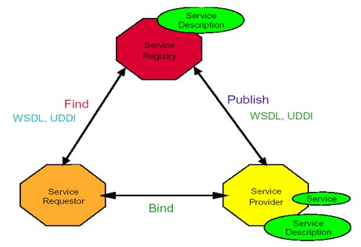
Web Service Model

Slide 17
Roles in Web Service Architecture
Service Provider
Owner of the service
Platform that hosts access to the service
Service Requestor
Business that requires certain functions to be satisfied
Application looking for and invoking an interaction with a service
Service Registry
Searchable registry of service descriptions where service providers publish their service descriptions

Slide 18
Operations in Web Service Architecture
Publish
Service descriptions need to be published in order for service requestor to find them.
Find
Service requestor queries the service registry for the service required
Bind
Service requestor invokes or initiates an interaction with the service at runtime

Slide 19

Thank You

